Slide 1

Women In Tech

Slide 2
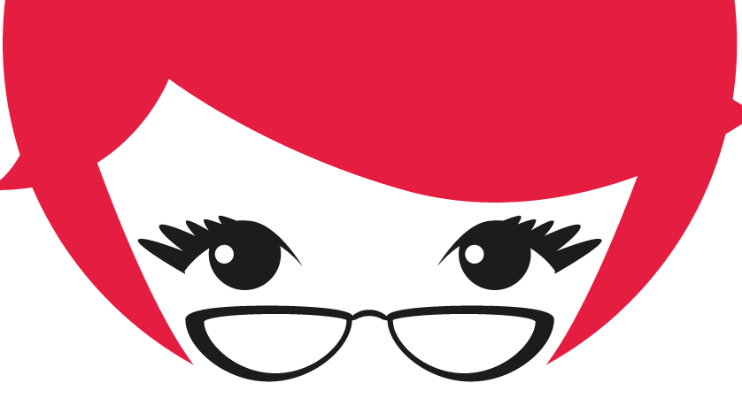
Why do we need women in Tech?
Notes:
Number of women working is reducing ?
Because we actually need more people in tech. Tech is being used in every walk of life. Every single technology is applied everywhere and we need good people to build it. Where would we find the people if 50% of the people aren’t participating. We need more people to work so we can get there – How will we become developed if 50% of the population does not work and pay taxes – and doesn’t participate
The female employment rate in India, counting both the formal and informal economy, has tumbled from an already-low 35% in 2005 to just 26% now.
Diversity will bring about better innovations, different perspectives , newer ideas.
There are all sorts of statistics out there talking about the number of women in tech, the gender ratio- you can easily find out
http://blog.belong.co/gender-diversity-indian-tech-companies
From what I have observed, in India there’s much more women in tech than in the US. The number is around 25-30%.
From there a lot of men and women tend to quit tech around 10 yrs of ex. They go into product, marketing, consulting etc.
We found that for every 100 testing jobs, there were 34 women compared to 66 men. When it came to hardcore programming roles, the ratio changed to 25 : 75.
The number of women in C level roles around 6%.
So what does this mean for us? If you like engineering, and you want to grow, there’s plenty of opportunity for you.
SOCIETY. CONFIDENCE. COMMUNITY.
What stops a lot of the people from grabbing the opportunity?
Robotics club – Very less women.
boys are encouraged from a young age to play with robots and space toys while the girls are given barbies and stu. Plus the expectation from the ”society”.
Stereotypical – NERD is always a guy - glasses- There is no representation for women
These are bigger problems that will take the collective effort of the whole country and mindsets to change.
But what can you do to bring about this change ?
1. Often I have observed, in the starting stages when people often ask for help, men and women – both – do this mistake. They let the other person take the keyboard and fix it for them. They never learn , sometimes don’t have the opportunity to learn how to do it by themselves. This is a lifehack. Ask for help. But never ever let someone else fix it for you. Always be curious- learn what caused the issue and fix it yourself. Ask for steps but never let someone. else fix something for you. This sometimes happen a lot more women with women
2. Encourage other women/girls that you know to code. Explore options in engineering. The question is not about capability. Its about cultivating interests. Not a lot of people, especially girls, are exposed to how exciting technology can be. So always network and encourage other women to take active part in the community.
3. When there is an underrepresented minority- there are issues and challenges – but fortunately in todays world, you have a whole lot of avenues to help you navigate through the issues. These issues can be easily solved when more women move to the work places
4. Have this I don’t care attitude about being around men/women. I work with men. I work with women. I don’t care. I like what I do, so I am going to do it anyway.
5. Sometimes people don’t understand they are being discriminatory because they haven’t been exposed. So just speak to them and advocate for women. Most often, I have seen it work. People understand.
6. Always be curious to learn how things work.
7. Always think about what you can do different with a technology or concept in hand
8. A lot of people *especially women- tell me they don’t want to be in engineering because they have to constantly keep learning – this is a wrong attitude- if you have a problem with learning - whatever field you are in – you are not going to be successful. It is one of the reasons why I find tech very simulating. There is always something new you can learn everyday. . Always be open to learning.
9. Always be open to criticism, don’t be too attached to your code. Just keep an open mind – Tech is an exciting field to be in, with plenty of opportunities, flexibility – etc

Slide 3
Organizations
Notes:
AnitaB.org (formerly Anita Borg Institute for Women and Technology, and Institute for Women in Technology) is a global nonprofit organization based in Palo Alto, California. Recruit, Retain and advance women in tech.
Confrences, backto work program, codathons, local community
Women Who Code is an international non-profit organization that provides services for women pursuing technology careers and a job board for companies seeking coding professionals. The company aims to provide an avenue into the technology world by evaluating and assisting women developing technical skills. In addition to training, professional evaluations, meetings, and scholarships, Women Who Code offers networking and mentorship. As of 2018, the organization has executed more than 8,000 free events around the world, built a membership of over 167,000, and has locations in 60 cities in over 20 countries.
Girls Who Code is a nonprofit organization which aims to support and increase the number of women in computer science. The organization is working to close the gender employment difference in technology and change the image of what a programmer looks like. They have a 7-week Summer Immersion Program, a 2-week specialized Campus Program, after school Clubs, and a 13-book New York Times best-selling series.^{[2]} The aim is to inspire, educate, and equip young women with the computing skills to pursue 21st century opportunities.
Girls in Tech is a global non-profit organization focused on the engagement, education, and empowerment of women in technolog
Girl Develop It (GDI) is a nonprofit organization devoted to getting women the materials they need to pursue careers in software development. It provides affordable programs for adult women interested in learning web and software development in a judgment-free environment.^{[1]} Their mission is to give women of any income level, nationality, education level, and upbringing an environment in which to learn the skills to build websites and learn code to build programs with hands-on classes in two countries in 56 cities
Django Girls is an international non-profit organization started by two Polish women, Ola Sitarska and Ola Sendecka,^{[1]} to inspire women from all backgrounds^{[2]} to get interested in technology and to become programmers,^{[3]} offering a safe and friendly environment.^{[4][5]} It is known for the free workshops it hosts to help women to learn to program^{[6]} and for its Djangotutorial.^{[7]} It is often supported by the Python Software Foundation.^{[8]}
freeCodeCamp is a non-profit organization that consists of an interactive learning web platform, an online community forum, chat rooms, Medium publications and local organizations that intend to make learning web development accessible to anyone.

Slide 4
Open Source

Slide 5
Some twitteratis
https://twitter.com/reshmasaujani
https://twitter.com/geekgirlweb
https://twitter.com/nehanarkhede
https://twitter.com/mrogati
https://twitter.com/jeresig
https://twitter.com/6Gems
https://twitter.com/triketora
https://twitter.com/venikunche
https://twitter.com/karpathy
.. Many more! Look around, find your interests!
Notes:
Reshma Saujani - Founder/CEO @GirlsWhoCode.
Geekgirlweb- Rebecca Technical PM | Advocate for #WomenInTech
Neha narkhede Co-founder, CTO/CPO @confluentinc, Co-creator @apachekafka,
Monica Rogati- Data Science & AI advisor; fractional CDO. Former VP of Data @Jawbone & @LinkedIn data scientist
John Resig Creator of jQuery
6Gems Founder @BlackGirlsCode
Trikotera – Tracy Chou- Active on Quora
Veni @codewithveni . Working on @diversifytechco - For underrepresented people in tech to find tech opportunities

Slide 6
Resources
https://medium.com/netflix-techblog
https://engineering.linkedin.com/blog
https://www.mongodb.com/blog
https://blog.codinghorror.com/

Slide 7
Conferences
PyCon - October 12 - 15, 2019
React India - 26th – 28th September
KubernetesDay - March 23
ReactFoo 2019 - 2 March
WiDS (Women In Data Science) - 9th March
GIDS (Great International Developer Summit) - April 22-26
GHCI - November (Tentative) SciPyIndia – November (Tentative)
JSFoo 2019 – 27-28 September

Slide 8
Hackathons

Slide 9
FEEL FREE TO CONTACT ME
janani.balasubramanian93@gmail.com
https://www.linkedin.com/in/jananib93/

